Slide 1
Chapter 8. NP-complete problems

Slide 2
Search problems搜索问题

Slide 3
Eﬃcient algorithms
We have developed algorithms for
finding shortest paths in graphs,
minimum spanning trees in graphs,
matchings in bipartite graphs,
maximum increasing subsequences,
maximum flows in networks,
......
All these algorithms are efficient性能好的、高效的, because
in each case their time requirement grows as a polynomial
function (such as n, n², or n³) of the size of the input.

Slide 4
Exponential search space指数级的选择空间中，
选一个解
In all these problems we are searching for a solution (path, tree, matching, etc.) from among an exponential population of possibilities.
All these problems could in principle be solved in exponential time by checking through all candidate solutions, one by one.
But an algorithm whose running time is 2^{n}, or worse,
is all but useless in practice.

Slide 5
Exponential search space, cont’d.
The quest for efficient algorithms is about finding clever ways to bypass避开 this process of exhaustive search穷举, using clues from the input in order to dramatically narrow down the search space.
Now will see some other “search problems” in which again we are seeking a solution with particular properties among an exponential chaos of alternatives. The fastest algorithms we know for them are all exponential.

Slide 6

Satisfiability
The instances of Satisfiability or sat:
That is, a Boolean formula in conjunctive normal form (CNF).
It is a collection of clauses (the parentheses), each consisting of the disjunction (logical or, denoted ∨) of several literals, where a literal is either a Boolean variable (such as x) or the negation of one (such as ).
A satisfying truth assignment is an assignment of false or true to each variable so that every clause contains a literal whose value is true.

Slide 7
Satisfiability (cont’d)
The sat problem is the following: given a Boolean formula in conjunctive normal form, either find a satisfying truth assignment or else report that none exists.
sat is a typical search problem.
We are given an instance I (that is, some input data specifying the problem at hand, in this case a Boolean formula in conjunctive normal form), and we are asked to find a solution S (an object that meets a particular specifiation, in this case an assignment that satisfies each clause).
If no such solution exists, we must say so.

Slide 8
Search problems
A search problem is specified by an algorithm C that takes two inputs, an instance I and a proposed solution S, and runs in time polynomial in |I|.
We say S is a solution to I if and only if C(I, S) = true.

Slide 9
The traveling salesman problem
In the traveling salesman problem (tsp) , we are given n vertices 1,...,n and all n(n − 1)/2 distances between them, as well as a budget预算 b.
We are asked to find a tour, a cycle that passes through every vertex exactly once, of total cost b or less – or to report that no such tour exists.
That is, we seek a permutation τ(1),...,τ(n) of the vertices
such that when they are toured in this order,
the total distance covered is at most b:
d_{τ(1),τ(2)} + d_{τ(2),τ(3)} + ··· + d_{τ(n), τ(1)} ≤ b.
Notes:
一位月入五万的95后：这三件事，往往决定一个人所处的层次
广告·伟易 · 猎媒

Slide 10
The traveling salesman problem, cont’d
We have defined the tsp as a search problem:
Given an instance, find a tour within the budget
(or report that none exists).
But why are we expressing the traveling salesman problem in this way, when in reality it is an optimization problem, in which the shortest possible tour is sought?

Slide 11
Search vs. optimization
Turning an optimization problem into a search problem does not change its difficulty at all, because the two versions reduce to one another.
Any algorithm that solves the optimization tsp also readily solves the search problem: find the optimum tour and if it is within budget, return it; if not, there is no solution.
Conversely, an algorithm for the search problem can also be used to solve the optimization problem:
First suppose that we somehow knew the cost of the optimum tour; then we could find this tour by calling the algorithm for the search problem, using the optimum cost as the budget.
We can find the optimum cost by binary search.

Slide 12
Then why search instead of optimization?
Isn’t any optimization problem also a search problem in
the sense that we are searching for a solution that has
the property of being optimal?
The solution to a search problem should be easy to recognize, or as we put it earlier, polynomial-time checkable.
Given a potential solution to the tsp, it is easy to check
the properties “is a tour” (just check that each vertex is visited exactly once) and “has total length≤ b.”
But how could one check the property “is optimal”?

Slide 13
Euler Path
Euler Path:
Given a graph, find a path that contains each edge exactly once.
The answer is yes if and only if
(a) the graph is connected and
every vertex, with the possible exception of two vertices (the start and final vertices of the walk), has even degree.
Using above, it is easy to see that there is a polynomial time algorithm for Euler Path.

Slide 14
Rudrata Cycle
Rudrata Cycle:
Given a graph, find a cycle that visits each vertex exactly once.
In the literature this problem is known as the Hamilton cycle problem.

Slide 15
Minimum Cut
A cut is a set of edges whose removal leaves a graph disconnected.去掉这些边后，图变成不连通了
minimum cut: given a graph and a budget b, find a cut
with at most b edges.
This problem can be solved in polynomial time
by n−1 max-ﬂow computations:
give each edge a capacity of 1, and find the maximum flow
between some fixed node and every single other node.
The biggest such flow will correspond
(via the max-ﬂow min-cut theorem) to the smallest cut.

Slide 16
Balanced Cut
In many graphs, the smallest cut leaves just a singleton vertex on one side – it consists of all edges adjacent to this vertex.
Far more interesting are small cuts that partition the vertices
of the graph into nearly equal-sized sets.
balanced cut
Given a graph with n vertices and a budget b, partition
the vertices into two sets S and T such that |S|,|T| ≥ n/3
and such that there are at most b edges between S and T.

Slide 17
Three-dimensional matching
3D matching:
There are n boys and n girls, but also n pets,
and the compatibilities among them are specified by a set of triples, each containing a boy, a girl, and a pet.
Intuitively, a triple (b, g, p) means that boy b, girl g, and pet p get along well together.
We want to find n disjoint triples and thereby create
n harmonious households.

Slide 18
Independent set, vertex cover, and clique
Independent set:
Given a graph and an integer g, find g vertices, no two of which have an edge between them.
vertex cover:
Given a graph and an integer b, find b vertices cover (touch)
every edge.

Slide 19
Longest path
longest path: Given a graph G with nonnegative edge weights and two distinguished vertices s and t, along with a goal g.
We are asked to find a path from s to t with total weight at least g. To avoid trivial solutions we require that the path be simple, containing no repeated vertices.

Slide 20
Subset sum
subset sum:
Find a subset of a given set of integers that adds up to exactly W.

Slide 21
NP-complete problems

Slide 22
Hard problems, easy problems
Hard problems (NP-complete) | Easy problems (in P)
3sat | 2sat, Hornsat
Traveling salesman problem | Minimums panning tree
Longest path | Shortest path
3D matching | Bipartite matching
knapsack | Unary knapsack
Independent set | Independent set on trees
Integer linear programming | Linear programming
Rudrata path | Euler path
Balanced cut | Minimum cut

Slide 23
NP
Recall a search problem is defined by:
There is an eﬃcient checking algorithm C that takes as input the given instance I, as well as the proposed solution S, and outputs true if and only if S really is a solution to instance I.
Moreover the running time of C(I, S) is bounded by a polynomial in |I|, the length of the instance.
We denote the class of all search problems by NP.

Slide 24
P
We’ve seen many examples of NP search problems that are solvable in polynomial time多项式时间.
In such cases, there is an algorithm that takes as input an instance I and has a running time polynomial in |I|. If I has a solution, the algorithm returns such a solution; and if I has no solution, the algorithm correctly reports so.
The class of all search problems that can be solved in polynomial time is denoted P.

Slide 25
Why P and NP?
P: Polynomial time
NP: Nondeterministic Polynomial time

Slide 26
P = NP?
Input:
Problem:
A mathematical statement ϕ and n.
Find a proof of ϕ of length ≤ n if there is one.
The task of finding a proof for a given mathematical assertion is a search problem and is therefore in NP, because a formal proof of a mathematical statement is written out in excruciating detail, it can be checked mechanically, line by line, by an efficient algorithm.
So if P= NP, there would be an efficient method to
prove any theorem, thus eliminating the need for mathematicians!

Slide 27
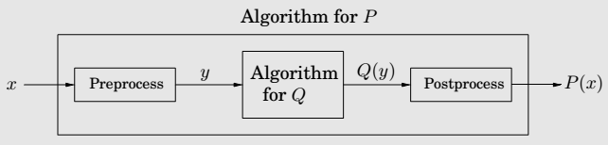
Reduction

Slide 28
Reductions, again
Even if we believe P = NP, what about the specific problems
on the left side of the table?
On the basis of what evidence do we believe that these particular problems have no efficient algorithm?
Such evidence is provided by reductions, which translate one search problem into another.
We will show that the problems on the left side of the table are all, in some sense, exactly the same problem, the hardest search problems in NP.
If even one of them has a polynomial time algorithm,
then every problem in NP has a polynomial time algorithm.

Slide 29
Reduction between search problems
A reduction from search problem A to search problem B is a polynomial time algorithm f that transforms any instance I of A into an instance f (I) of B, together with another polynomial time algorithm h that maps any solution S of f (I) back into a solution h(S) of I.
If f (I) has no solution, then neither does I.如果对B没解
则对A也没解
These two translation procedures f and h imply that any algorithm for B can be converted into an algorithm for A by bracketing it between f and h.

Slide 30
NP-completeness
Definition
A search problem is NP-complete if all other search problems reduce to it.
要证明npc问题的思路就是：
先证明它至少是一个NP问题，再证明其中一个已知的NPC问题能约化到它。
Remark
It is not clear a priori先验的 that NP-complete problems exist at all.

Slide 31
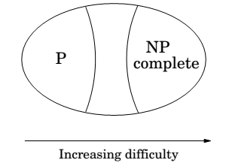

Slide 32
The two ways to use reductions
Assume there is a reduction from a problem A to a problem B.
A → B.
If we can solve B efficiently, then we can also solve A efficiently. If we know A is hard, then B must be hard too.
Reductions also have the convenient property
that they compose合成的.
If A → B and B → C, then A → C.

Slide 33
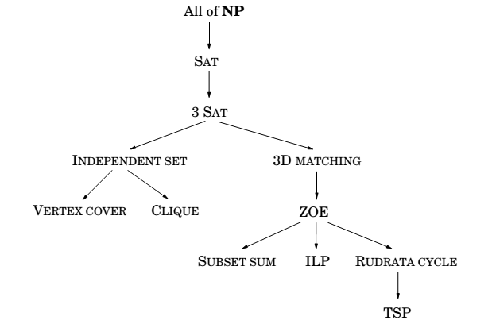

Slide 34
The Reductions for NP-Complete Problems

Slide 35
Rudrata (s,t)-Path → Rudrata Cycle
Rudrata Cycle problem: given a graph, is there a
cycle that passes through each vertex exactly once?
We can also formulate the closely related Rudrata (s,t)-Path problem, in which two vertices s and t are speciﬁed, and we want a path starting at s and ending at t that goes through each vertex exactly once.
Is it possible that Rudrata Cycle is easier than Rudrata
(s,t)-Path?
We will show by a reduction that the answer is no.

Slide 36
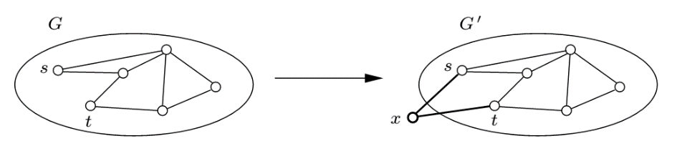
Rudrata (s,t)-Path → Rudrata Cycle, cont’d
The reduction maps an instance (G = (V,E), s, t) of
Rudrata (s,t)-Path into an instance G’ = (V’ ,E’ ) of Rudrata Cycle as follows: G’ is simply G with an additional vertex x and two new edges {s, x} and {x, t}.

Slide 37
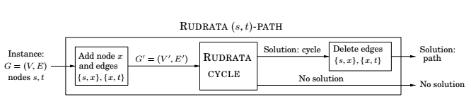

Slide 38
Independent Set → Vertex Cover
To reduce Independent Set to Vertex Cover we just need to notice that a set of nodes S is a vertex cover of graph G = (V, E) (that is, S touches every edge in E) if and only if the remaining nodes, V − S, are an independent set of G.
Therefore, to solve an instance (G, g) of Independent Set, simply look for a vertex cover of G with |V| − g nodes.
If such a vertex cover exists, then take all nodes not in it.
If no such vertex cover exists, then G cannot possibly have
an independent set of size g.

Slide 39
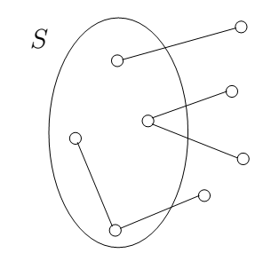

Slide 40
Special cases
3Sat is a special case of Sat, or, Sat is a generalization of 3Sat. By special case we mean that the instances of 3Sat are a subset of the instances of Sat (in particular, the ones with no long clauses), and the deﬁnition of solution is the same in both problems (an assignment satisfying all clauses).
Consequently, there is a reduction from 3Sat to Sat,
in which the input undergoes no transformation,
and the solution to the target instance is also kept
unchanged.

Slide 41
Special cases
In other words, functions f and h from the reduction diagram are both the identity.
It is a very useful and common way of establishing that a problem is NP-complete: Simply notice that it is a generalization of a known NP-complete problem.
For example, the Set Cover problem is NP-complete because it is a generalization of Vertex Cover.

Slide 42
Any problem in NP → Sat
Outline of the basic idea: First, we shall show that all problems in NP can be reduced to a generalization of Sat, i.e., Circuit Sat.电路可满足
In Circuit Sat we are given a (Boolean) circuit, a dag whose vertices are gates of five different types:
1. AND gates and OR gates have indegree 2.
2. NOT gates have indegree 1.
3. Known input gates have no incoming edges and are labeled false or true.
4. Unknown input gates have no incoming edges and are labeled “?”.
One of the sinks of the dag is designated as the output gate.

Slide 43
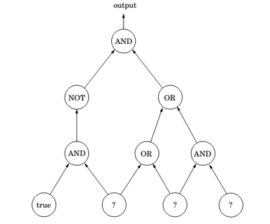
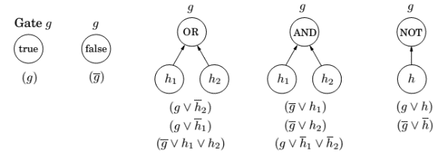
Any problem in NP → Sat (cont.)

Slide 44
Any problem in NP → Sat (cont.)
Any polynomial algorithm can be rendered as a circuit, whose input gates encode the input to the algorithm.
The satisfying truth assignments to the unknown inputs of the circuit are in one-to-one correspondence with the solutions of instance I of problem A.

Slide 45
Unsolvable Problems
At least an NP-complete problem can be solved by some algorithm—the trouble is that this algorithm will be exponential.
But it turns out there are perfectly decent computational problems完全像样的计算问题 for which no algorithms exist at all!
One famous problem of this sort is an arithmetical version of SAT. Given a polynomial equation in many variables, perhaps
x³yz + 2y⁴z² − 7xy⁵z = 6
are there integer values of x, y, z that satisfy it? There is no algorithm that solves this problem. Such problems are called unsolvable.

Slide 46
Chapter 9. Coping with NP-completeness
Intelligent exhaustive search
Approximation algorithms
Local search heuristic

